Slide 1
ScienceQtech Employee Performance Mapping. Course-end Project 1
Submitted By:
Sagar Sarolia
MS Data Science Job guarantee Aug 2022 Cohort 2
Email: saroliasagar@yahoo.com

Slide 2
INTRODUCTION
ScienceQtech is a startup that works in the Data Science field. ScienceQtech has worked on fraud detection, market basket, self-driving cars, supply chain, algorithmic early detection of lung cancer, customer sentiment, and the drug discovery field. With the annual appraisal cycle around the corner, the HR department has asked you (Junior Database Administrator) to generate reports on employee details, their performance, and on the project that the employees have undertaken, to analyze the employee database and extract specific data based on different requirements.

Slide 3
Objective:
To facilitate a better understanding, managers have provided ratings for each employee which will help the HR department to finalize the employee performance mapping. As a DBA, you should find the maximum salary of the employees and ensure that all jobs are meeting the organization's profile standard. You also need to calculate bonuses to find extra cost for expenses. This will raise the overall performance of the organization by ensuring that all required employees receive training.

Slide 4
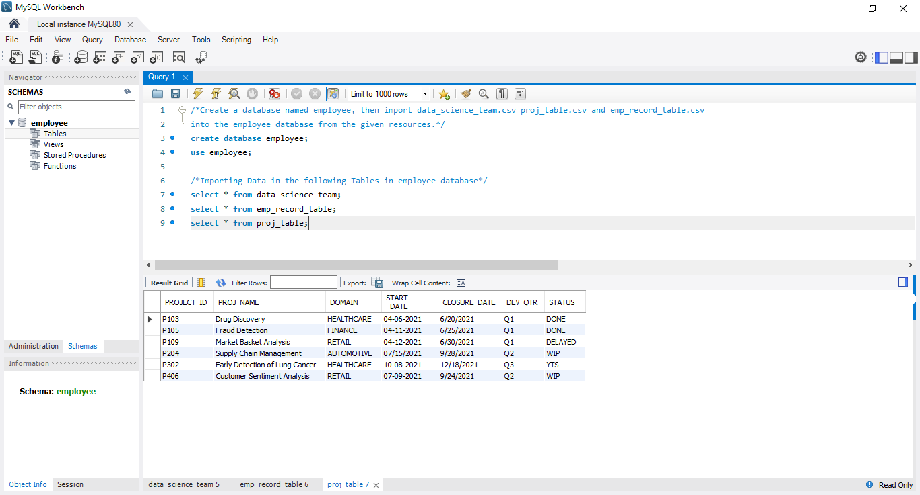
Task1: Create a database named employee, then import data_science_team.csv proj_table.csv and emp_record_table.csv into the employee database from the given resources.

Slide 5
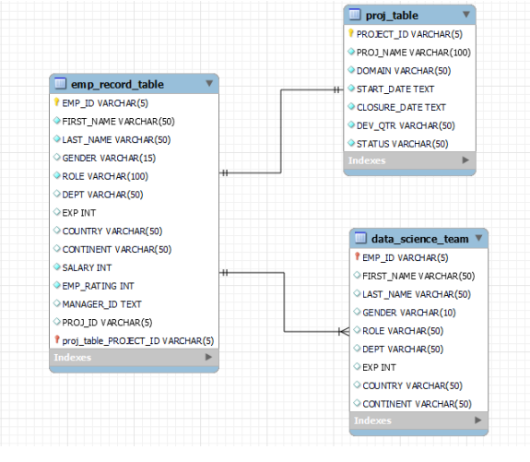
Task 2: Create an ER diagram for the given employee database.

Slide 6
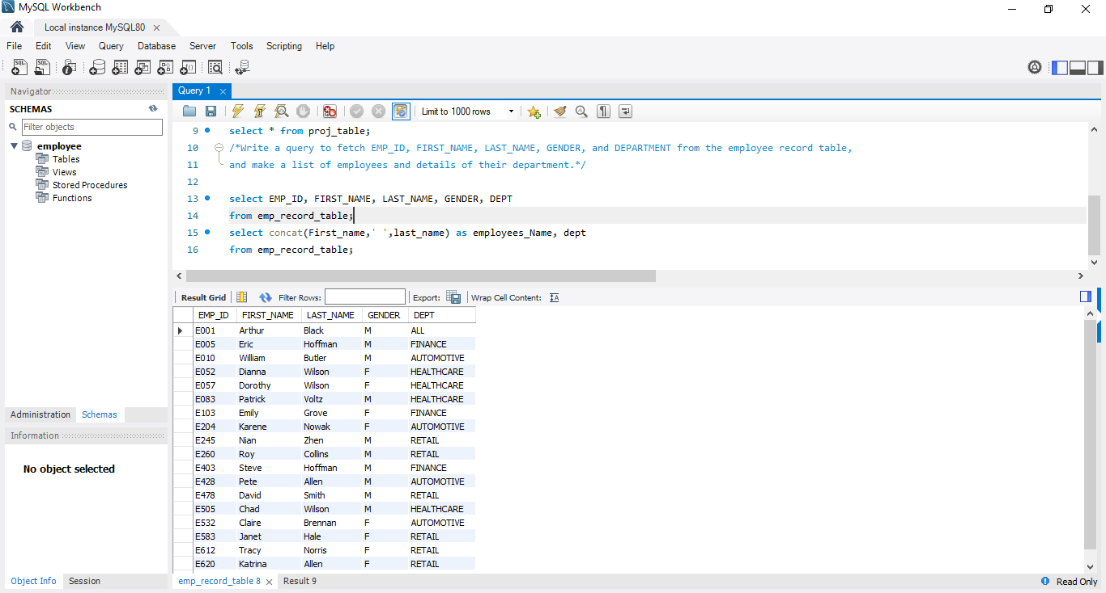
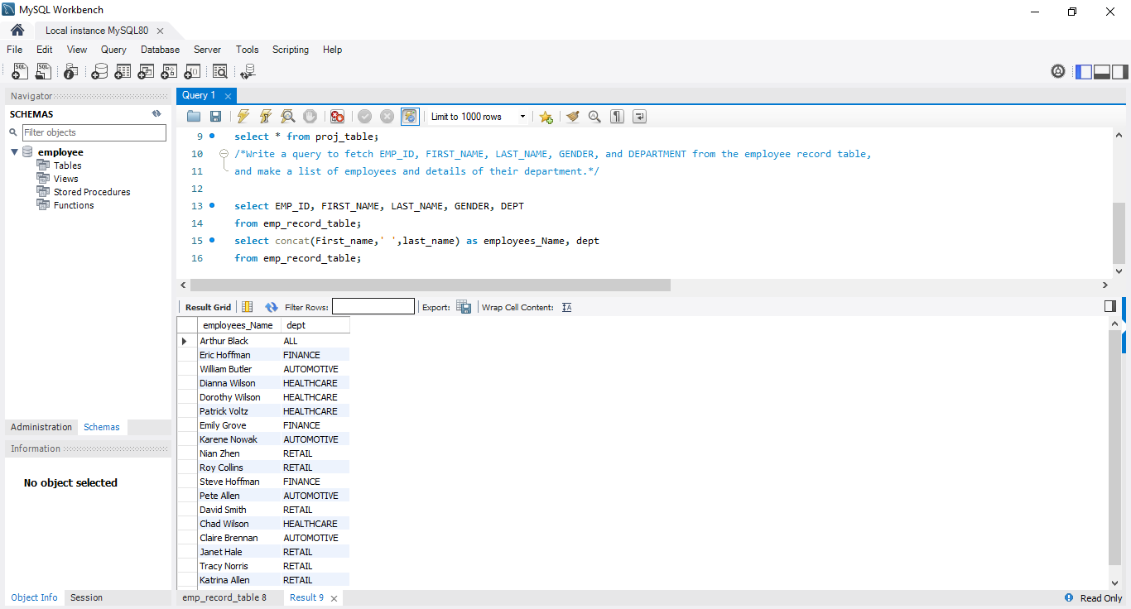
Task 3: Write a query to fetch EMP_ID, FIRST_NAME, LAST_NAME, GENDER, and DEPARTMENT from the employee record table, and make a list of employees and details of their department.

Slide 7
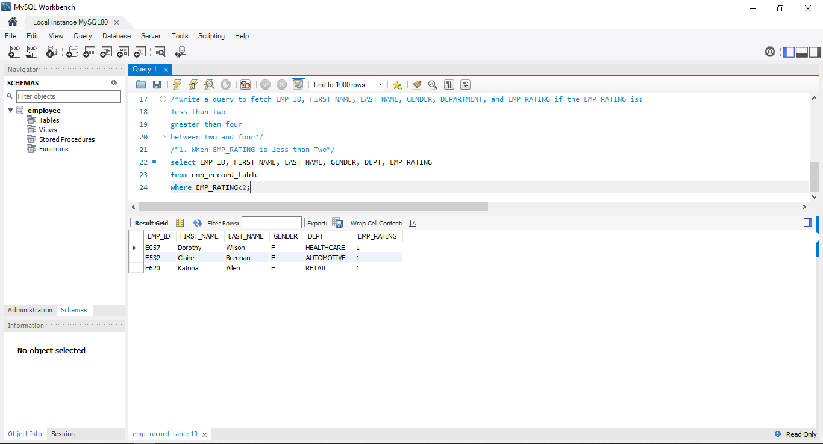
Task 4: Write a query to fetch EMP_ID, FIRST_NAME, LAST_NAME, GENDER, DEPARTMENT, and EMP_RATING if the EMP_RATING is: less than two, greater than four , between two and four
Less than 2

Slide 8
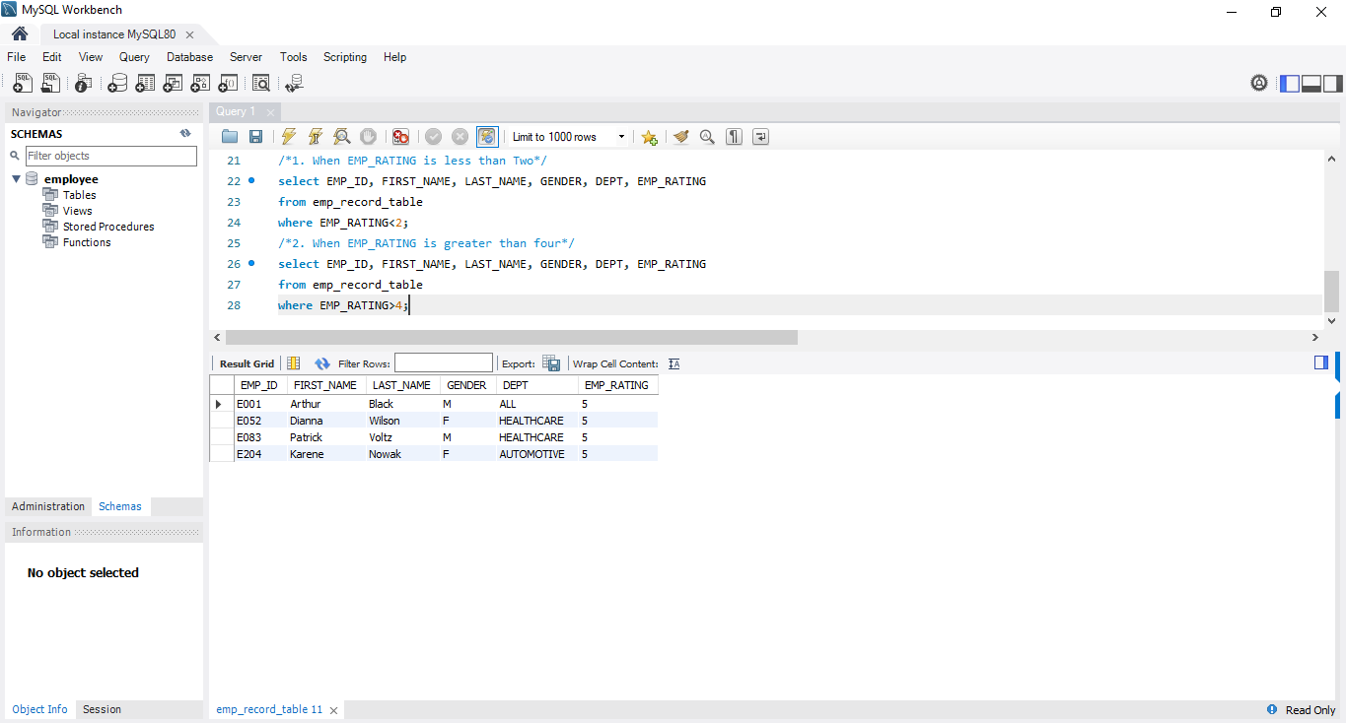
Task 4: Write a query to fetch EMP_ID, FIRST_NAME, LAST_NAME, GENDER, DEPARTMENT, and EMP_RATING if the EMP_RATING is: less than two, greater than four , between two and four
Greater than 4

Slide 9
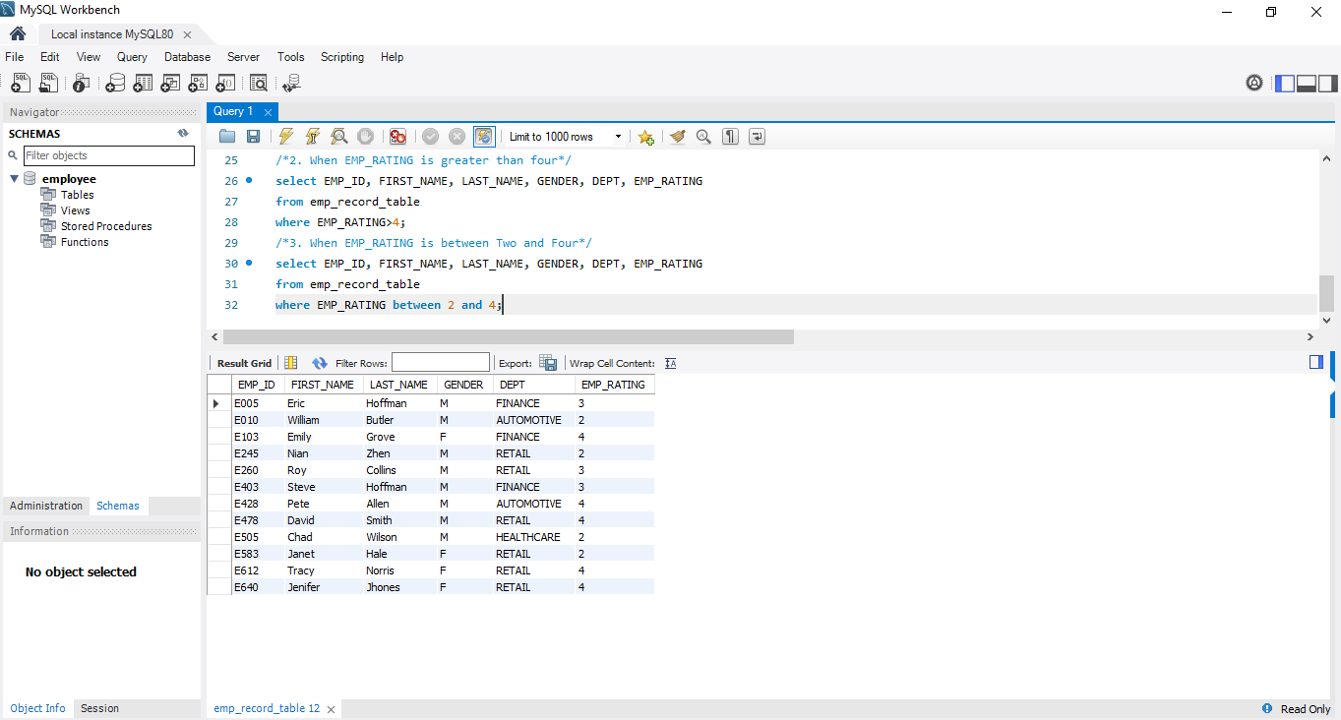
Task 4: Write a query to fetch EMP_ID, FIRST_NAME, LAST_NAME, GENDER, DEPARTMENT, and EMP_RATING if the EMP_RATING is: less than two, greater than four , between two and four
Between 2 and 4

Slide 10
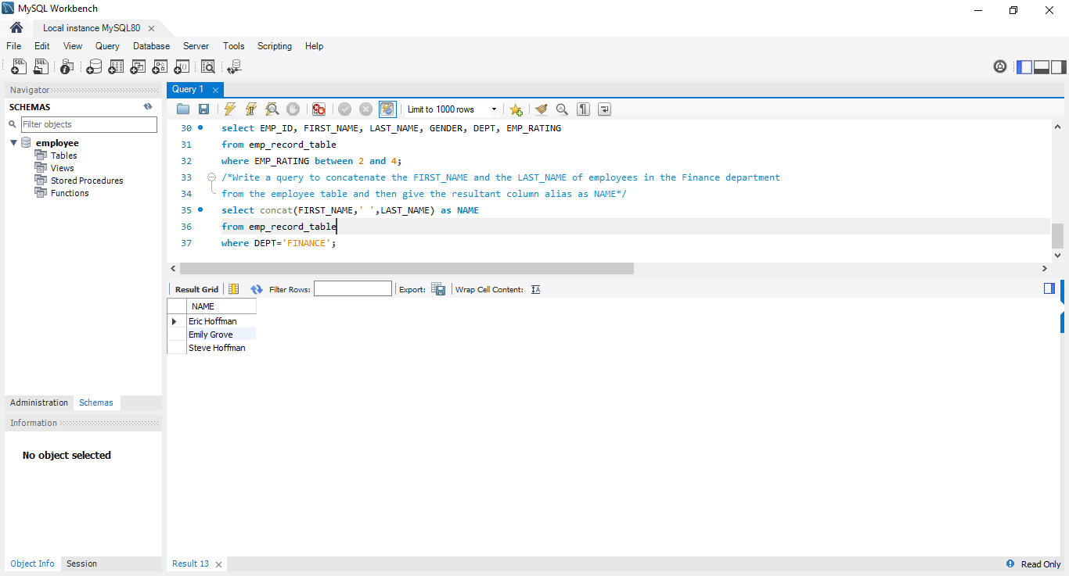
Task 5: Write a query to concatenate the FIRST_NAME and the LAST_NAME of employees in the Finance department from the employee table and then give the resultant column alias as NAME.

Slide 11
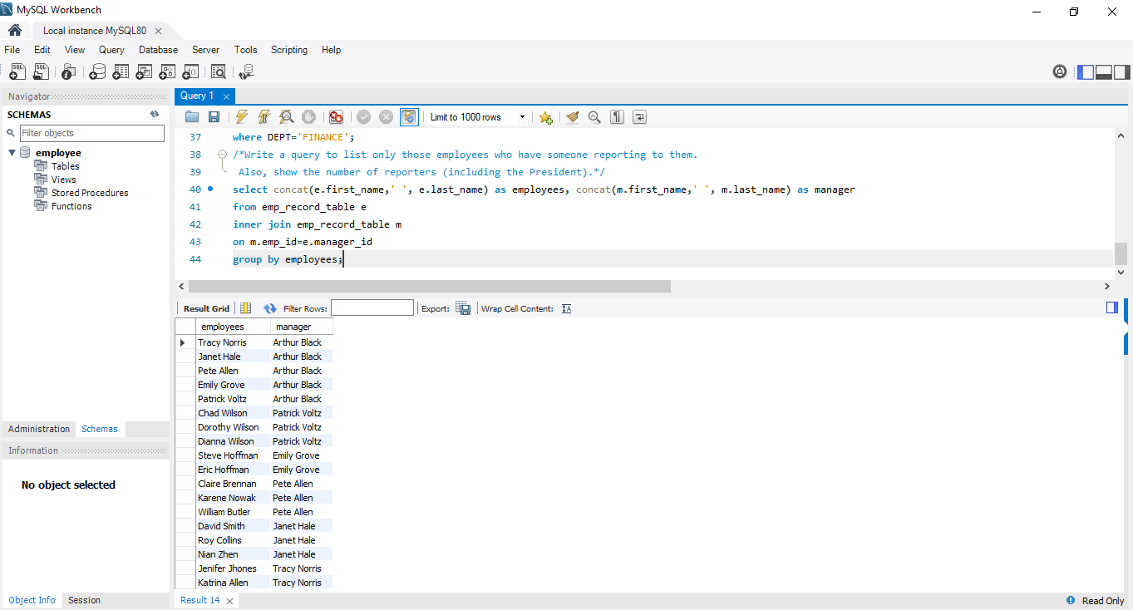
Task 6: Write a query to list only those employees who have someone reporting to them. Also, show the number of reporters (including the President).

Slide 12
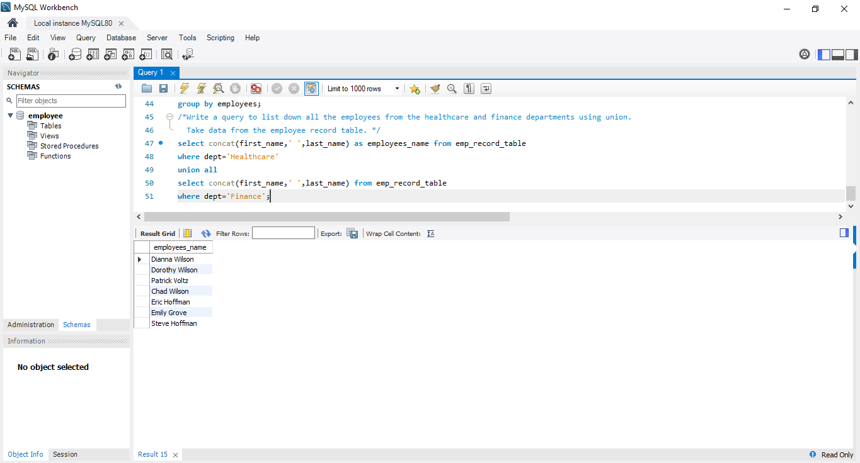
Task 7: Write a query to list down all the employees from the healthcare and finance departments using union. Take data from the employee record table.

Slide 13
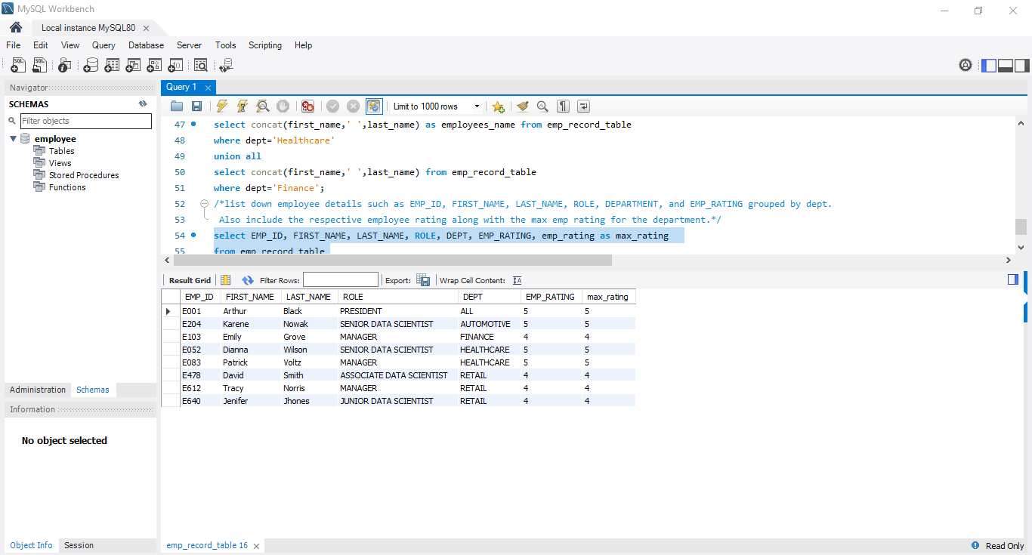
Task 8: Write a query to list down employee details such as EMP_ID, FIRST_NAME, LAST_NAME, ROLE, DEPARTMENT, and EMP_RATING grouped by dept. Also include the respective employee rating along with the max emp rating for the department.

Slide 14
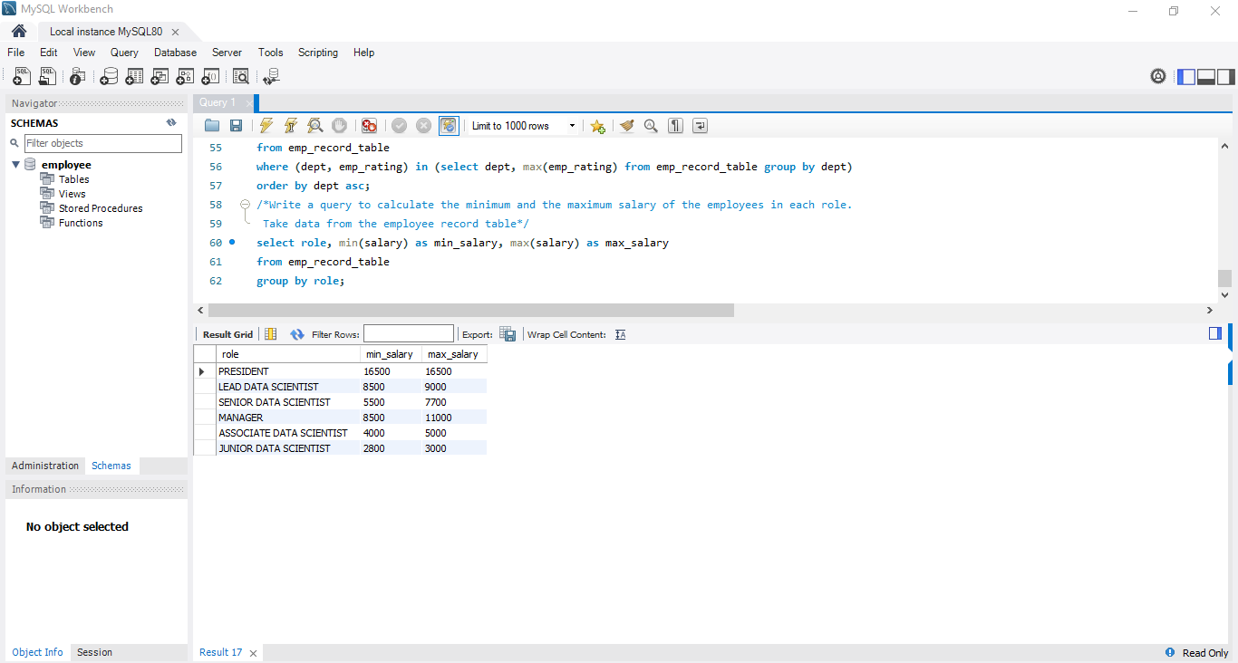
Task 9: Write a query to calculate the minimum and the maximum salary of the employees in each role. Take data from the employee record table.

Slide 15
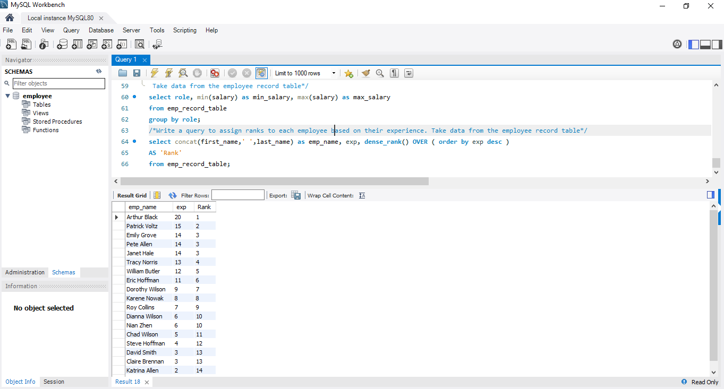
Task 10: Write a query to assign ranks to each employee based on their experience. Take data from the employee record table.

Slide 16
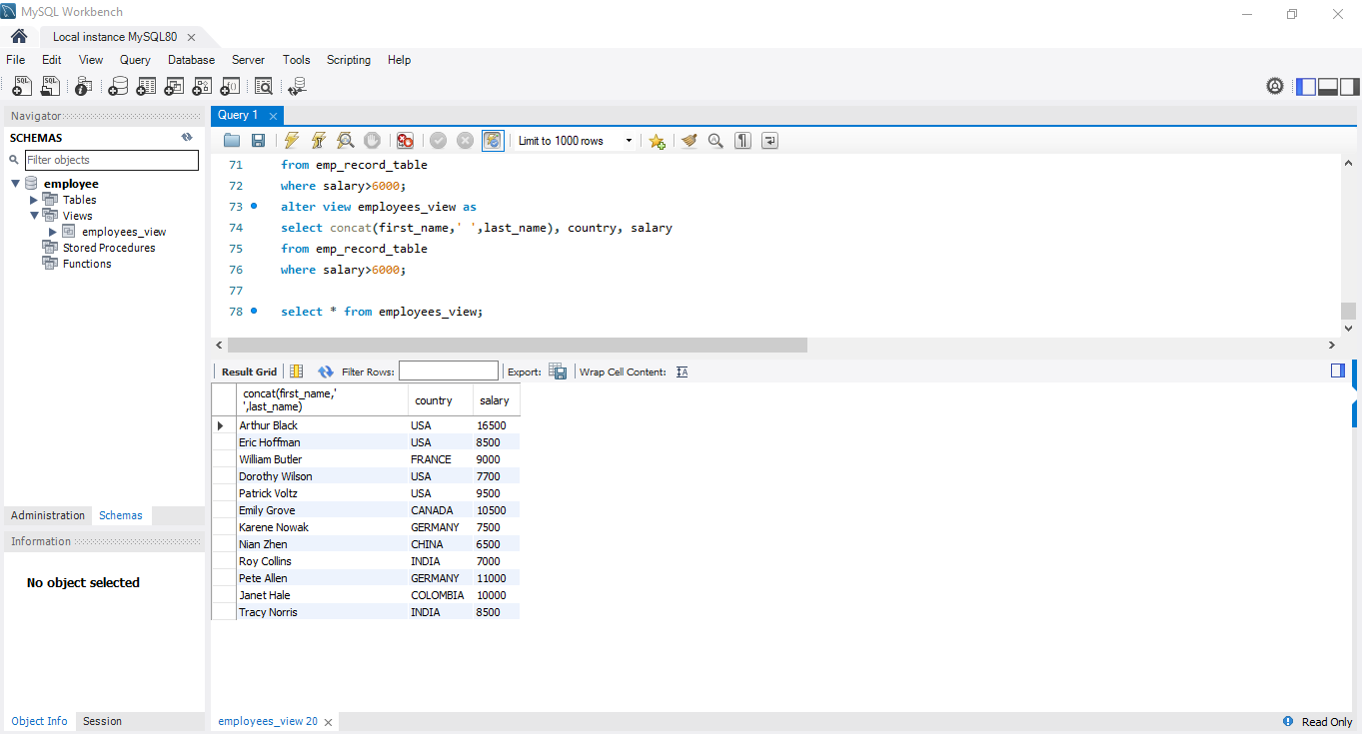
Task 11: Write a query to create a view that displays employees in various countries whose salary is more than six thousand. Take data from the employee record table.

Slide 17
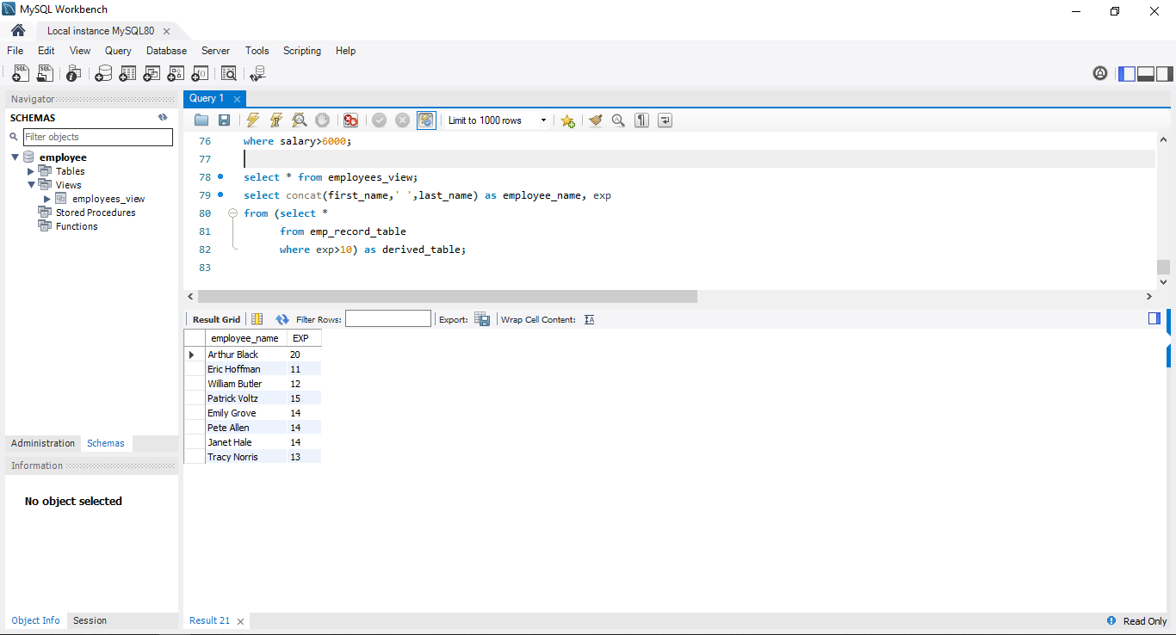
Task 12: Write a nested query to find employees with experience of more than ten years. Take data from the employee record table.

Slide 18
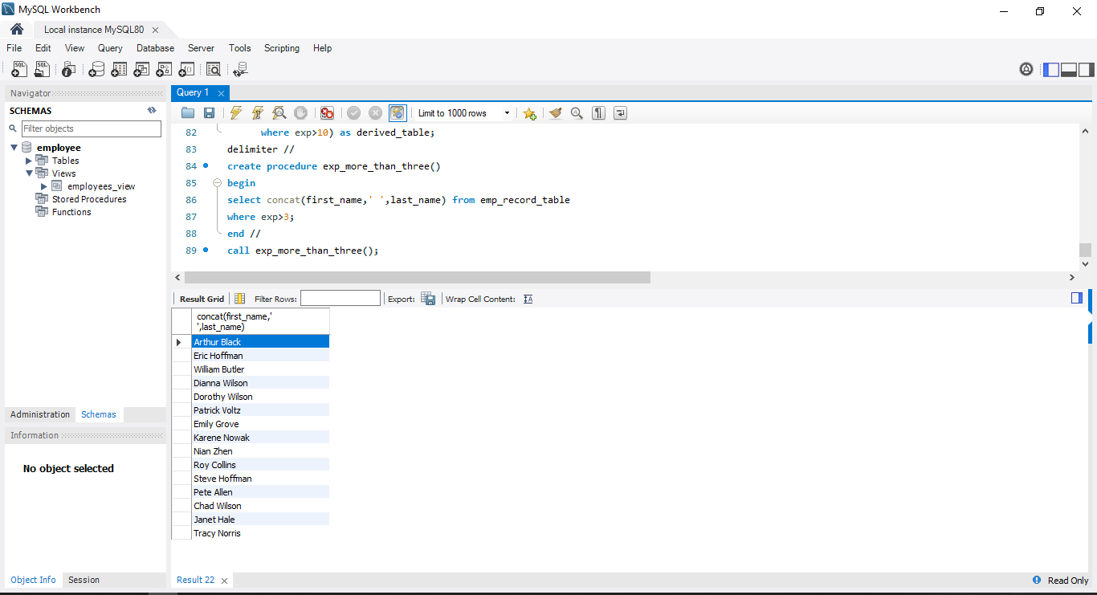
Task 13: Write a query to create a stored procedure to retrieve the details of the employees whose experience is more than three years. Take data from the employee record table.

Slide 19
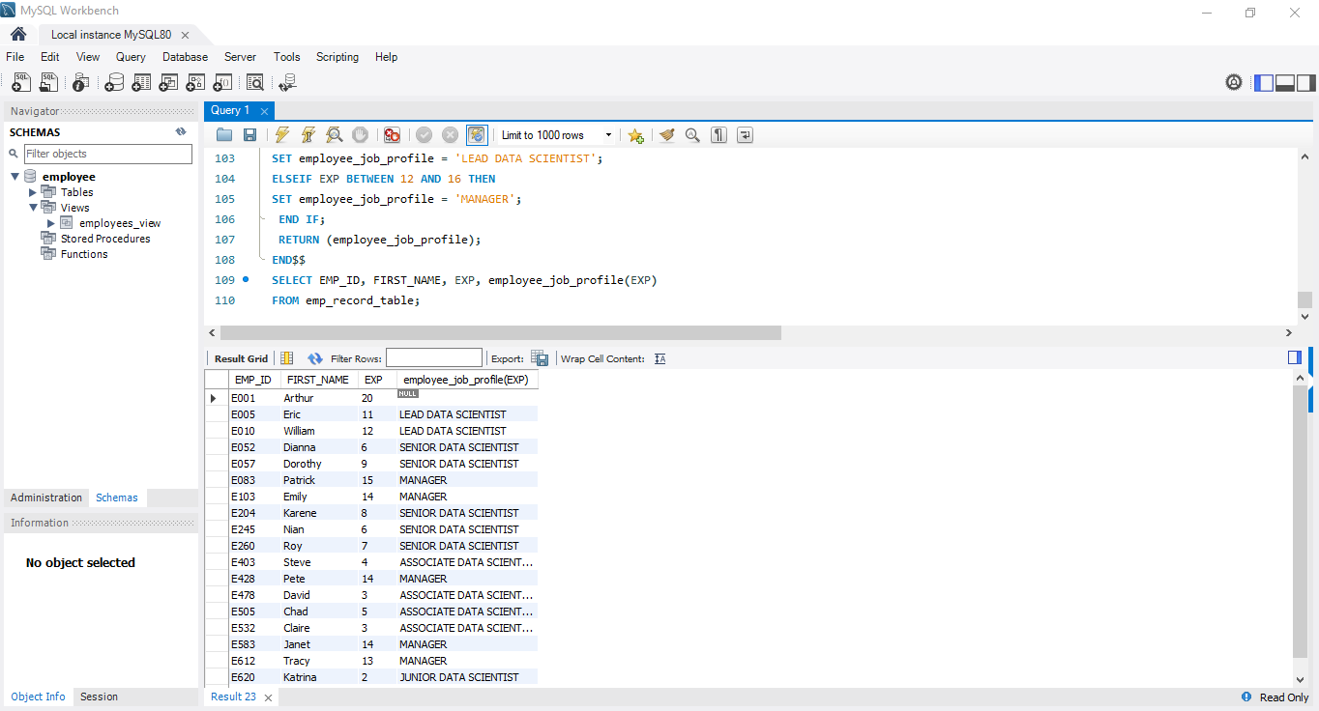
Task 14: Write a query using stored functions in the project table to check whether the job profile assigned to each employee in the data science team matches the organization’s set standard.

Slide 20
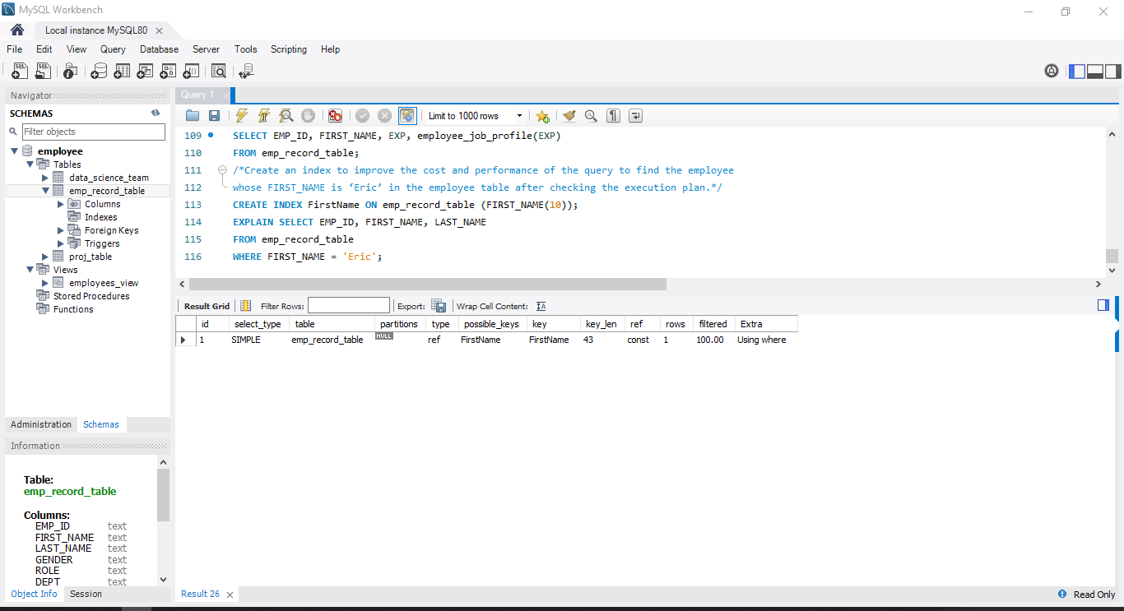
Task 15: Create an index to improve the cost and performance of the query to find the employee whose FIRST_NAME is ‘Eric’ in the employee table after checking the execution plan.

Slide 21
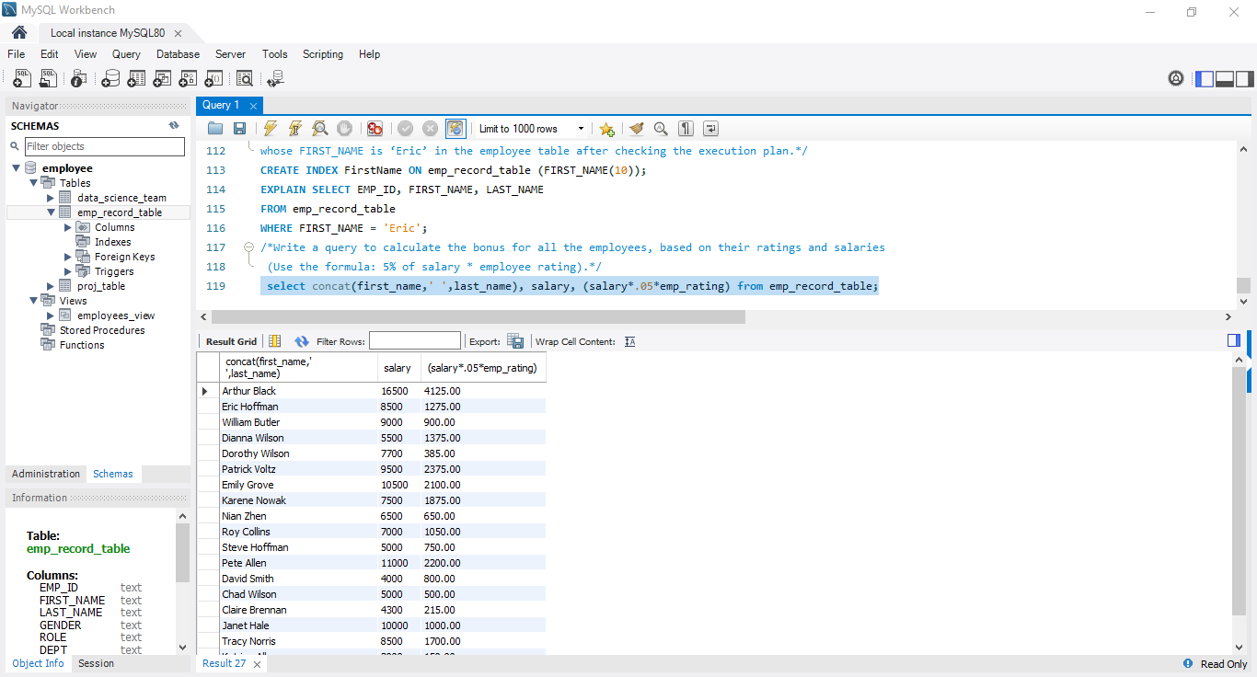
Task 16: Write a query to calculate the bonus for all the employees, based on their ratings and salaries (Use the formula: 5% of salary * employee rating).

Slide 22
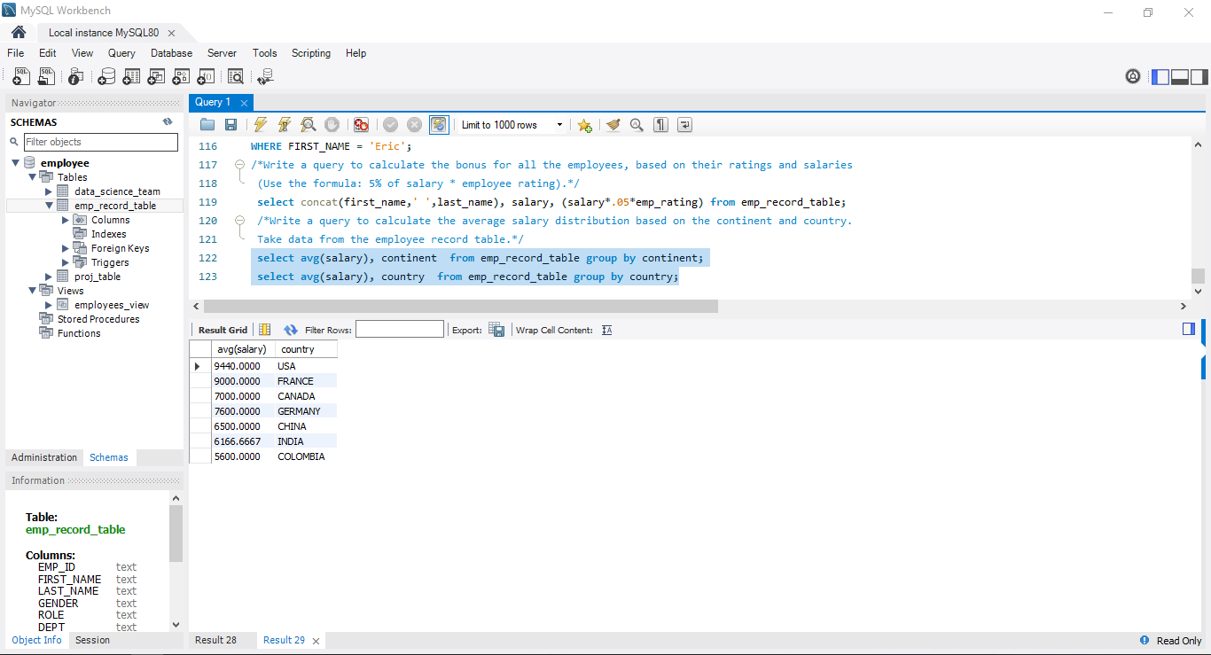
Task 17: Write a query to calculate the average salary distribution based on the continent and country. Take data from the employee record table.

